Slide 1
Foundations of Computer Science
---From Data Manipulation to Theory of Computation

Slide 2
自我介绍
SMH
姓名：孙铭会 博士 博士后
单位：吉林大学计算机科学与技术学院
Email：smh@jlu.edu.cn
主讲本科课程：计算机导论，人机交互技术，RFID实验，微机原理实验，数据库实验等
主讲研究生课程：面向对象数据库，计算机控制技术等

Slide 3
与大家交集：大学生创新训练项目，开放性大学生创新实验，毕业设计，研究生等
以及各项大赛：比如ICAN大赛，机器人大赛，数学建模大赛，物联网大赛

Slide 4
Welcome to Computer Science!
Challenging & exciting!
Computer networks,
Virtual reality,
Space exploration,
Computer-created special effects,
… 展示些cool的video或设备

Slide 5
Book’s outline
Chapter1: Introduction
Chapter2: Data Representation
Chapter3: Number Representation
Chapter4: Operations on Bits
Computers
and Data
Computer
Hardware
Chapter5: Computer Organization
Chapter6: Computer Networks
Chapter7: Operating System
Chapter8: Algorithms
Chapter9: Programming Language
Chapter10: Software Engineering
Book
organization
Computer
Software
Chapter11: Data Structures
Chapter12: Abstract Data Types
Chapter13: File Structures
Chapter14: Databases
Data
Organization
Chapter15: Data Compression
Chapter16: Security
Chapter17: Theory of Computation
Advanced
Topics

Slide 6

Bird’s-eye view
Book
organization
Computers
and Data
Computer
Hardware
Computer
Software
Data
Organization
Advanced
Topics
安全技术
人机交互
多媒体技术
图形学
计算机网络
接口技术
计算机组成原理
微机原理
数字电路
模拟电路
C，C++，Java语言
操作系统
算法
软件工程
编译原理
数据结构
面向对象技术
数据库

Slide 7
Chapter 1
Introduction

Slide 8
OBJECTIVES
After reading this chapter, the reader should be able to:
Understand the concept of a black box, a data processor,
and a programmable data processor.
Define the von Neumann model and name its
components: memory, arithmetic/logic unit, control unit,
and input/output.
Understand the stored program concept.
Understand the sequential execution of statements in a
program.
Name the components of a computer: hardware, software,
and data.

Slide 9
Contents
1.1 The Computer as a Black Box
1.2 Von Neumann Model
1.3 Computer hardware
1.4 Data
1.5 Computer software
1.6 History

Slide 10
1.1
THE COMPUTER
AS A BLOCK BOX

Slide 11
1.1 The computer as a black box
A computer is a programmable machine that receives input, stores and manipulates data//information, and provides output in a useful format.（ http://en.wikipedia.org ）
Computer Science: issues related to the computer.
If you are not concerned with the internal mechanisms of a computer, you can simply define it as a black box(黑盒).
We provide two common computer models.

Slide 12

Model I---Data processor model
Figure 1-1
specific-purpose machine model
This model is too general.
Another problem with this model is that it does not specify the type of processing or whether more than one type of processing is possible.
It’s a specific-purpose machine, and not a general-purpose machine.

Slide 13
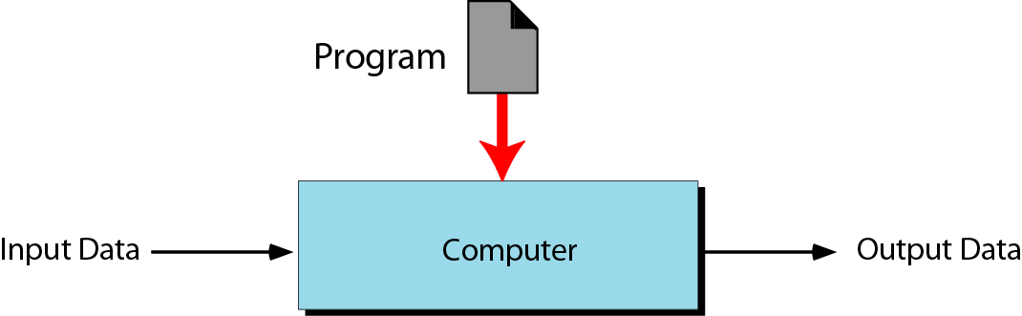
Model II--- Programmable data processor model
general-purpose machine model
Figure 1-2
f(InputData, Program)
Program is added.
A program is a set of instructions that tells the computer what to do with data.
A program is a set of instructions written in a computer language.

Slide 14
OutputData = f (InputData, Program)
The Three Cases:
Same program, different data.
Different programs, same data.
Same program, same data.

Slide 15
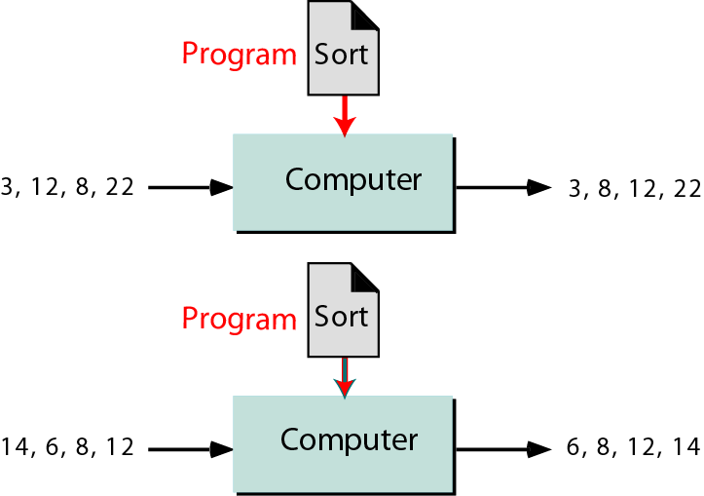
Case 1: Same program, different data
Figure 1-3

Slide 16
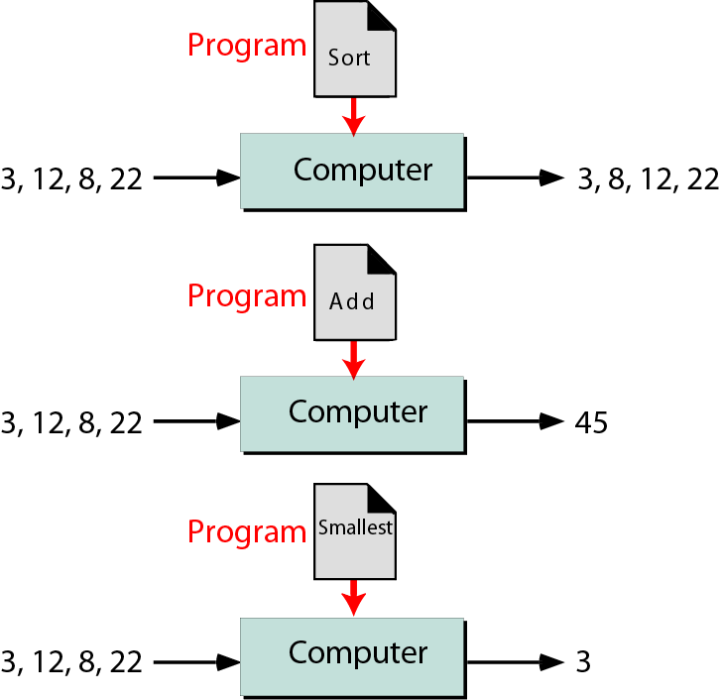
Case 2: Different programs, same data
Figure 1-4

Slide 17
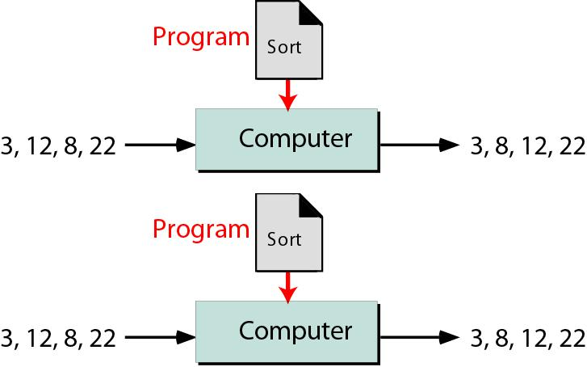
Case 3: Same program, same data

Slide 18
1.2
von NEUMANN
MODEL

Slide 19
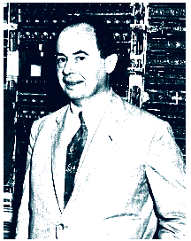
1.2 Von Neumann Model
Open the Black Box
Von neumann Model looks at the inside of the computer(Black box) and defines how processing is done.

Slide 20
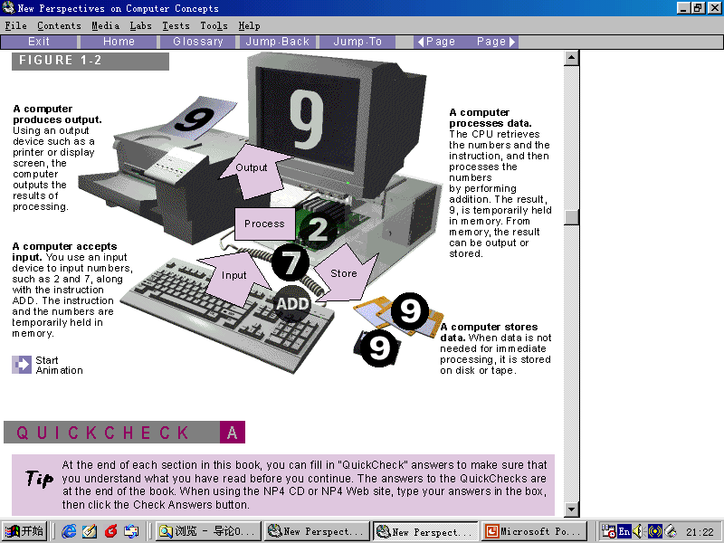
1.2 Von Neumann Model
Von Neumann Model defines a computer as four subsystems:
Memory,
Arithmetic logic unit,
Control unit,
Input/output.

Slide 21
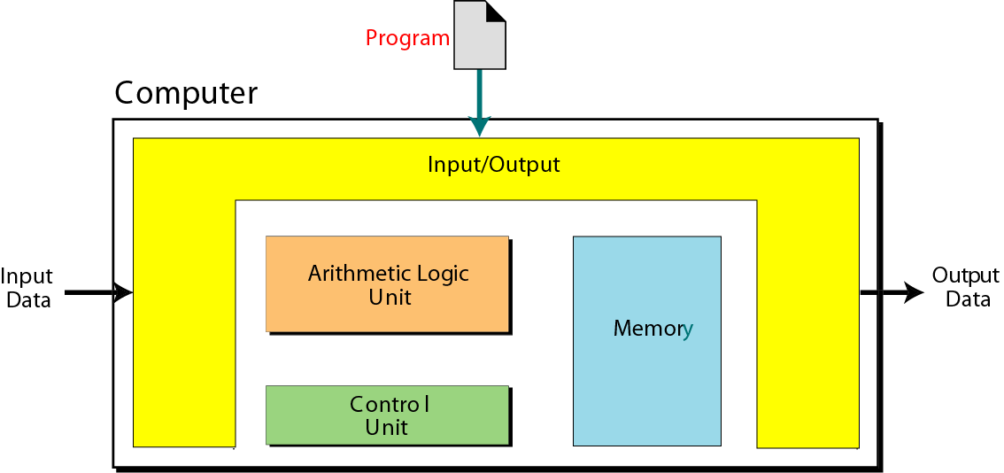
von Neumann model
Figure 1-5

Slide 22


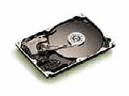

1.2 Von Neumann Model
Memory
Memory is the storage area.It is where programs and data are stored during processing.

Slide 23

1.2 Von Neumann Model
ALU(The Arithmetic logic unit) is where calculation and logical operations take place.
The Control unit controls the operations of memory,ALU,and I/O system.
In a computer , most processing takes place in a component called the central processing unit(CPU).

Slide 24





1.2 Von Neumann Model
Input/Output
Computer Input is whatever is put into a computer system. Output is the results produced by a computer.

Slide 25
1.2 Von Neumann Model
Stored Program
Von Neumann Model states that the program must be stored in memory.
The memory of modern computers hosts both a program and its corresponding data.
Both the data and programs are stored as binary patterns(a sequence of 0s and 1s) in memory.

Slide 26
1.2 Von Neumann Model
Sequential execution of instructions
A program in the Von Neumann Model is made of a finite number of instructions.The instructions are executed one after another.

Slide 27
1.2 Von Neumann Model
Summary
Von Neumann Model is based on three ideas:
Four subsystems.
Stored program.
Sequential execution of instructions.

Slide 28
1.3
COMPUTER
HARDWARE
Chapter 5

Slide 29
1.4
DATA

Slide 30
1.4 DATA
Storing data
If a computer is an electronic device, the best way to store data is in the form of an electrical signal, specifically its presence or absence.This implies that a computer can store data in one of two states(0 or 1).

Slide 31
1.4 DATA
Data Organizing
Although data should be stored only in one form(a binary pattern) inside a computer, data outside a computer can take many form.
Data are organized into small units, small units are organized into larger units, and so on.

Slide 32
1.5
COMPUTER
SOFTWARE

Slide 33
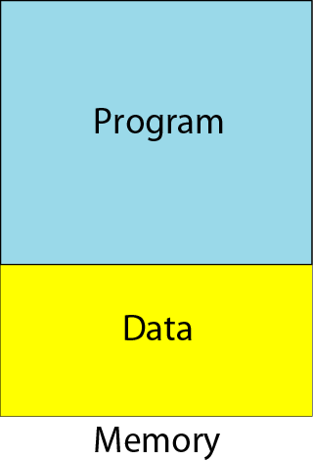
Program and data in memory
1、Programs and data must be stored.
Figure 1-6

Slide 34
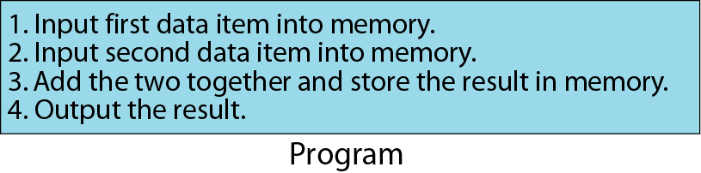
Program made of instructions
2、Programs must be a sequence of instructions.
Figure 1-7

Slide 35
1.5 Computer software
3、The step-by-step solution is called an algorithm.
4、Computer scientists came up with idea of using symbols to represent binary patterns.So the concept of computer languages was born.
5、Software engineering is the design and writing of structured programs.
6、An operating system originally worked as a manager to facilitate access of the computer components for a program.

Slide 36
1.6
HISTORY

Slide 37
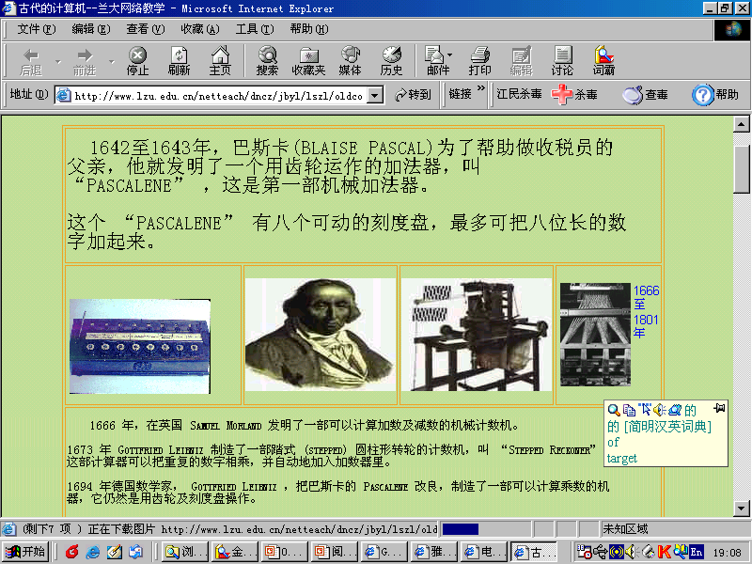
1.6 History
Mechanical machines(Before 1930)
1、Blaise Pascal invented Pascaline.
2、 Gottfried Leibnitz invented a more sophisticated mechanical calculator that could do multiplication and division as well as addition and subtraction. Leibnitz’s Wheel.

Slide 38
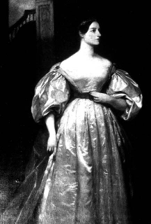
1.6 History
Mechanical machines(Before 1930)
3、The first machine that used the idea of storage and programming was the Jacquard loom(提花织机).
4、1823,Charles babbage invented a machine the analytical Engine.(Ada Augusta Lovelace,1815~1852)
5、1890, Herman Hollerith designed and built a programmmer machine that could automatically read, tally, and sort data stored on punched cards.
Ada

Slide 39
1.6 History
Birth of Electronic Computers(1930-1950)
1 、The first special-purpose computer is ABC(Atanasoff Berry Computer).
2、1930, under the direction of Howard Aliken to build a huge computer named Mark I.
3、Alan Turing invented a computer called Colossus(巨人) that was designed to break the German Enigma code.

Slide 40
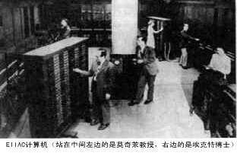
1.6 History
Birth of Electronic Computers(1930-1950)
4、 1946，ENIAC（The Electronic Numerical Integrator and Computer）,the first general-purpose,totally electronic computer.

Slide 41
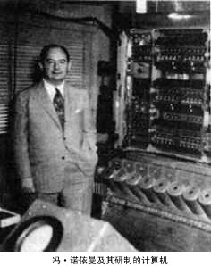
1.6 History
Birth of Electronic Computers(1930-1950)
The first computer based on Von Neumann’s idea was made in 1950 and was called EDVAC.

Slide 42
1.6 History
Computer generations(1950-present)
1、First generation(1950-1959)
vacuum tube(真空管)
2、 Second generation(1959-1965)
transistor(晶体管)
3、 Third generation(1965-1975)
Integrated circuit(IC，集成电路)
4、 Fourth generation(1975-1985)
the appearance of Microcomputer
5、 Fifth generation(1985- )

Slide 43
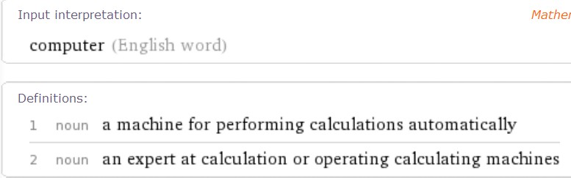
课后查找
http://en.wikipedia.org
A computer is a programmable machine that receives input, stores and manipulates data//information, and provides output in a useful format.
http://www.wolframalpha.com

